Slide 1
Poker Blinds Timer
Synthesis Vacation Work Project December 2023
Dan Rom

Slide 2
Introduction
This project aims to make the process of keeping track of the blinds, and when to increase them, simple and easy – allowing for the game of poker to run smoothly and without any unnecessary delays
Previously, employees at Synthesis have used a mobile application for managing the blinds of their poker games, however, they found that the application did not suit their needs. It needed SOMETHING. My web application aims to find this ‘something’ and deliver a truly effortless experience to those involved in the game

Slide 3
Feature Overview
The web application requires only two inputs from the user – the starting small blind value as well as the length of each ‘round’
After the required data is inputted, the user is taken to the ‘game screen’ where all information about the current round is visible. This includes round number, the current small and big blinds, as well as a timer counting down the time they have left in the current round
At the end of each round, an alert is played, informing the players that the blinds are now increasing. The displayed round information is updated, and the countdown is restarted
Users have the option to edit the length of the rounds during a game. This change is only implemented when the following round begins. This feature allows players to control the speed of the game. It could be useful for when the game is taking much longer than expected and players want to quicken the pace
The countdown can be paused and resumed at any time – allowing for small breaks in the game if needed.

Slide 4
Technology Stack
The frontend for this application makes use of React.js and the Next.js framework. It uses the axios library to handle API calls
The backend of the application is coded in Python – making use of the Flask web framework for building the API

Slide 5


Future Enhancements
I believe that this application has the potential for many additional, useful features.
Non-Linear Blind Increments:
Currently, the blinds are simply doubling each round. Implementing an algorithm to increase the blinds in a smarter, non-linear fashion could be a useful feature – introducing a more sophisticated and strategic way of incrementing the blinds.
Automatic Editing of Round Length:
In this version of the application, the length of the rounds is inputted by the user. It can be manually changed during the game. However, a useful feature could be to automate the changing of round lengths based on how far along the game is. This could create a more dynamic and responsive experience for users

Slide 6
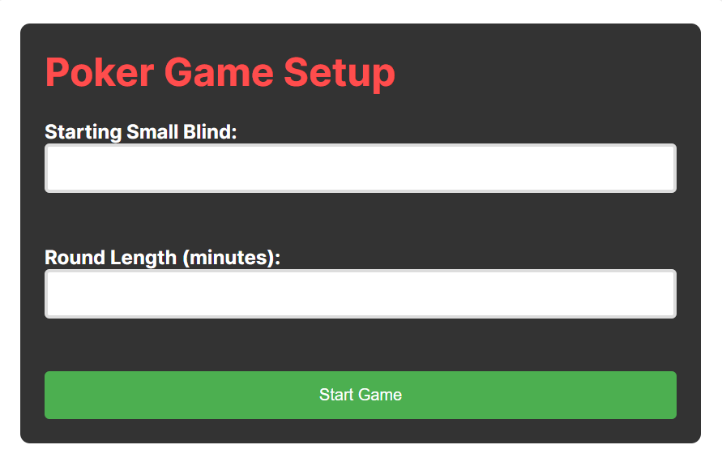
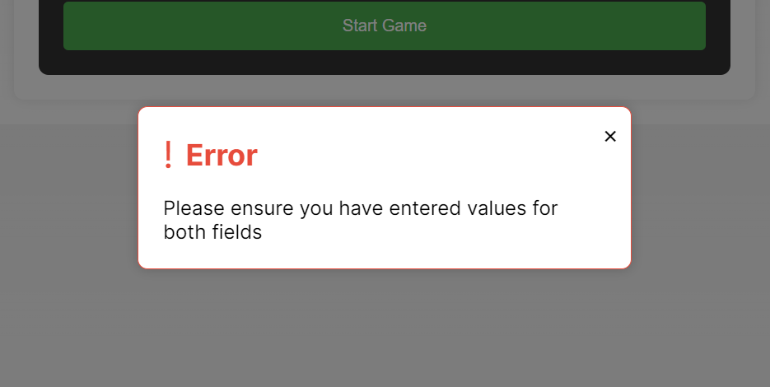
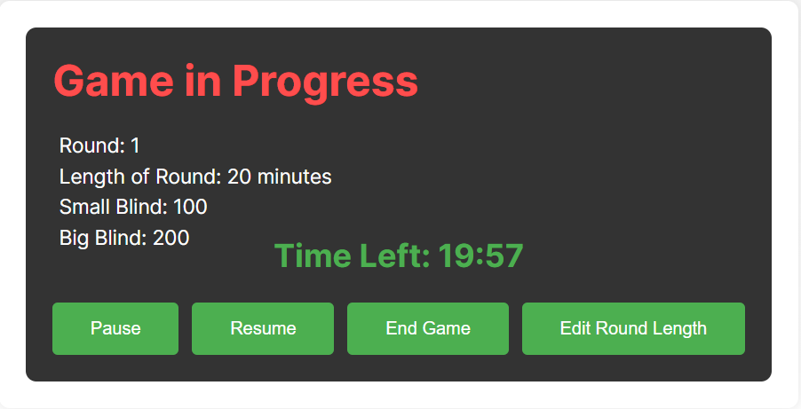
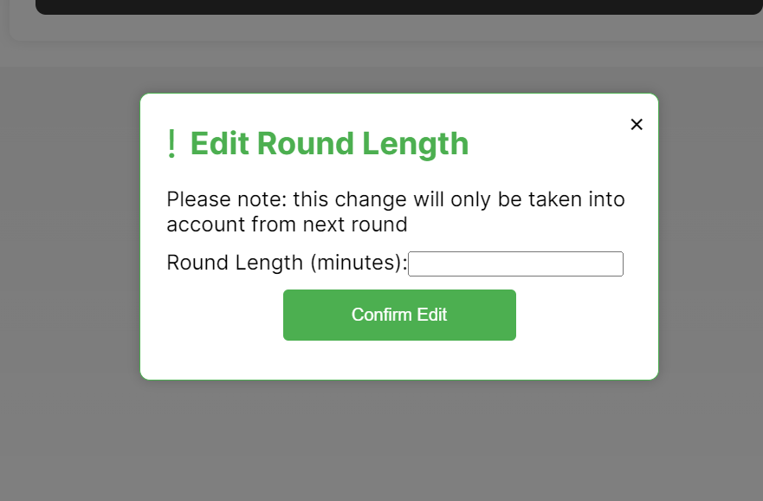
Application Demonstration

